Slide 1
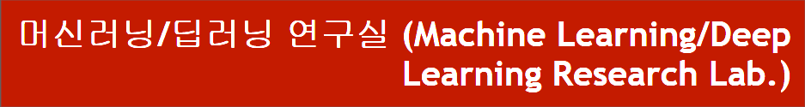
DARTS : DIFFERENTIABLE ARCHITECTURE SEARCH
동서대학교 대학원 컴퓨터공학과
Jie Yong Shin,
Dae-Ki, Kang , Prof (advisor)
2022.02.03
Notes:
1

Slide 2
CONTENTS
1. Summary
2. Search space
3. Continuous relaxation and optimization
4. Approximate architecture gradient
5. Results
6. Conclusion and Discussion
Notes:
2

Slide 3
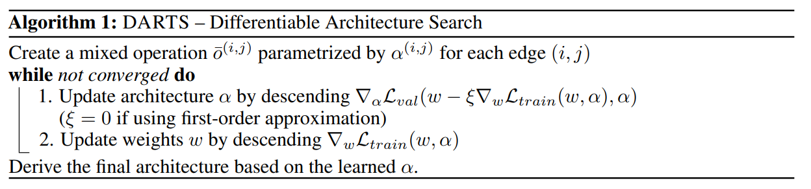
1. Summary
NAS를 강화 학습이나 진화 알고리즘으로 접근한 다른 논문들과 달리 Sequential Domain 내에서 그래프 토폴로지를 사용해서 미분가능하게 만들었고, 이를 통해 경사하강법으로 해결함
Notes:
3

Slide 4
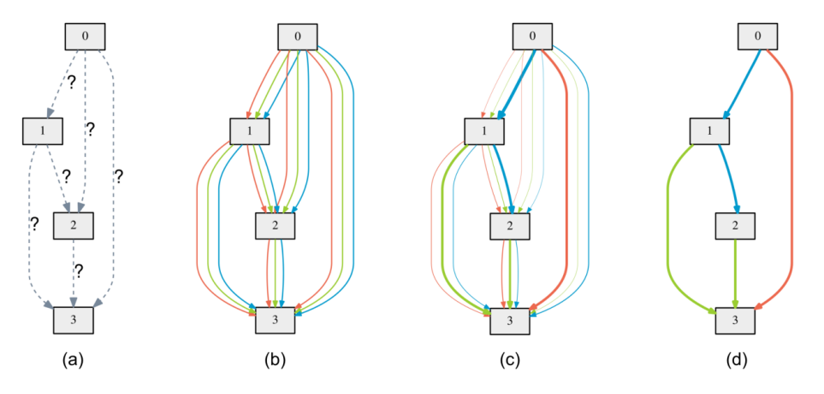
1. Summary
Search space는 DAG(Directed Acyclic Graph)로 정의
Notes:
4

Slide 5
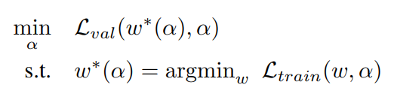
1. Summary
Optimize 하는 Loss는 train loss의 w와 validation loss의 α (operation의 weight)
Notes:
5

Slide 6
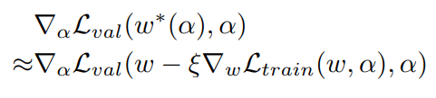
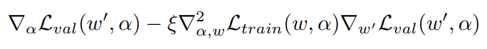
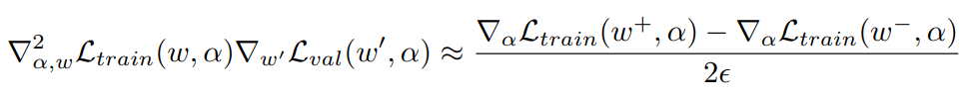
1. Summary
Search cost를 현저하게 줄인 Approximation
Notes:
6

Slide 7
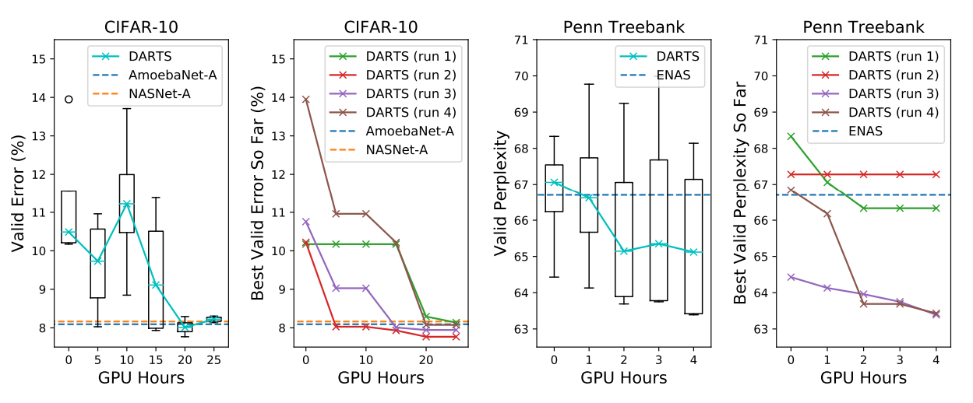
1. Summary
결과적으로 다른 SOTA 알고리즘들을 뛰어넘는 성능을 보임
Notes:
7

Slide 8
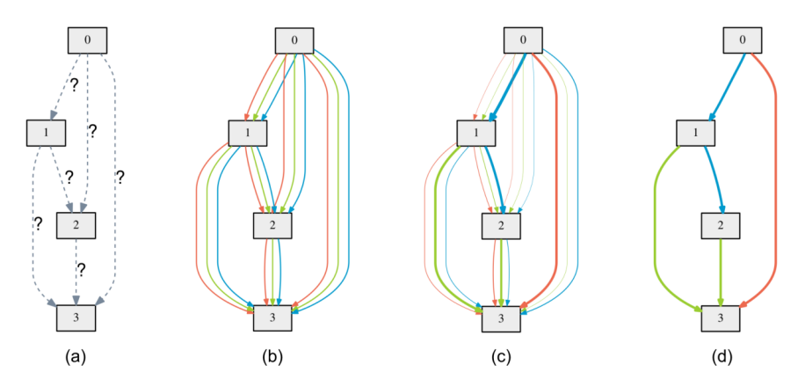
2. Search space
Directed Acyclic Graph
Notes:
8

Slide 9
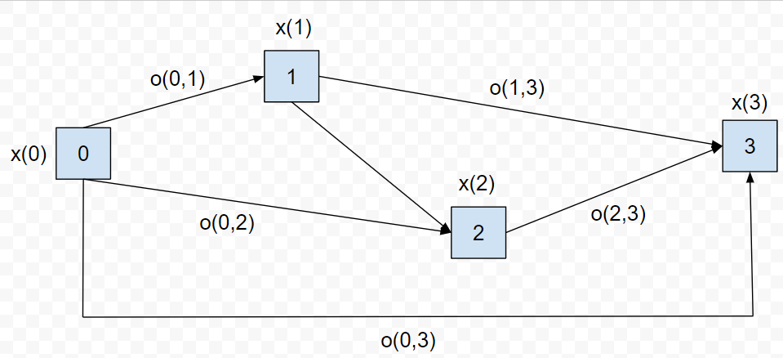
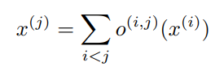
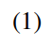
2. Search space
Directed Acyclic Graph
x(i) : input
x(j) : output
o(i,j) : operation (transforms x(i))
Notes:
9

Slide 10
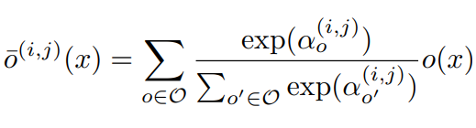
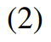
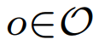
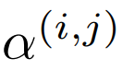
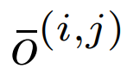
3. Continuous relaxation and optimization
Example of a set O : {convolution, pooling, none}
: Weights of operations (Vector)
: Mixed operation
Notes:
10

Slide 11
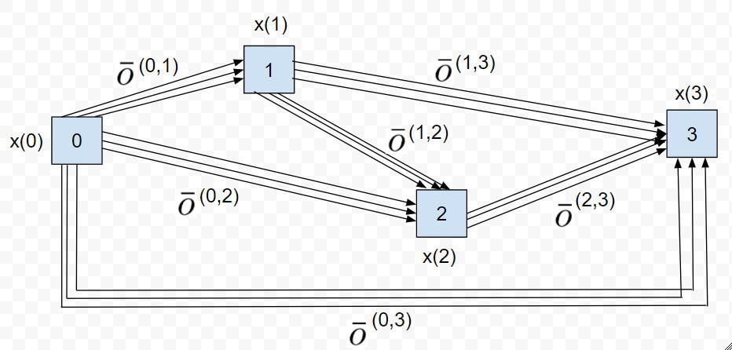
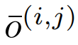
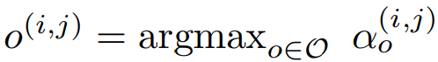
3. Continuous relaxation and optimization
The task of architecture search then reduces to learning a set of continuous variables α = { α (i,j) }
At the end of the search, replace
with
Notes:
11

Slide 12
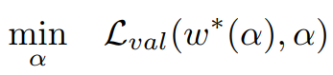
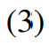
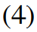
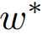
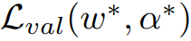
3. Continuous relaxation and optimization
: weight one step after w
Goal is to find α* that minimizes
(4) is bilevel optimization problem
Notes:
12

Slide 13
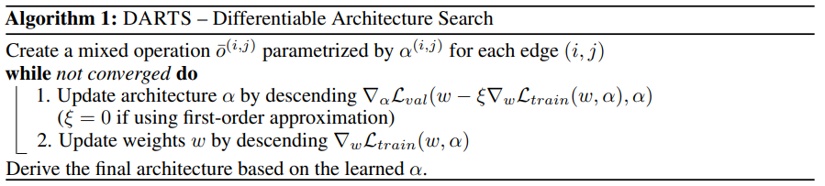
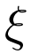
4. Approximation
: Learning rate for a step of inner optimization
Notes:
13

Slide 14
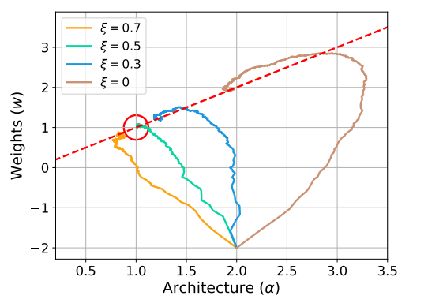
4. Results
The example shows that a suitable choice of ξ helps to converge to a better local optimum.
Notes:
14

Slide 15
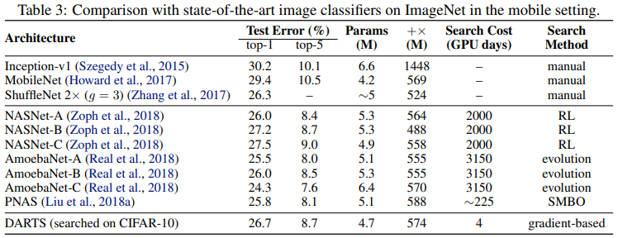
4. Results
Transfer learning with DARTS
Notes:
15

Slide 16
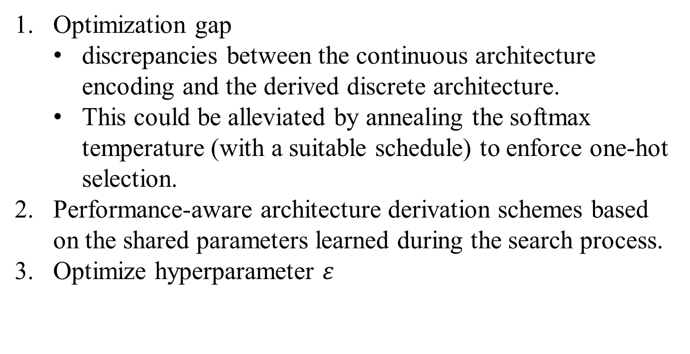
5. Conclusion
Optimization gap
discrepancies between the continuous architecture encoding and the derived discrete architecture.
This could be alleviated by annealing the softmax temperature (with a suitable schedule) to enforce one-hot selection.
Performance-aware architecture derivation schemes based on the shared parameters learned during the search process.
Optimize hyperparameter $ε$
Notes:
16

Slide 17
감사합니다.
Q & A
17
Notes:
-
The training of procedure for is to maximize the probability of D making a mistake. This framework corresponds to a minimax two-player game.
In the space of arbitrary functions G and D, a unique solution exists, with G recovering the training data distribution and D equal to ½ everywhere.
17

Slide 18
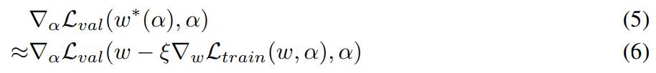
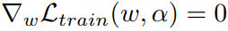
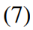
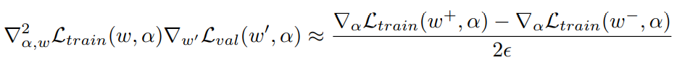
4. Approximation
Simple approximation
Approximate with one single step
Applying chain rule to the approximate architecture gradient
Finite difference approximation
Notes:
18

